Slide 1


Analyse The Report Of a Motor Insurance Company

Slide 2
Introduction
EDA Report (Practical Data Science Coursework)
All graphs have been calculated over a 12-month period
And all relevant outliers have been removed from the Claims Variable from the Data cleansing that has taken place.

Slide 3
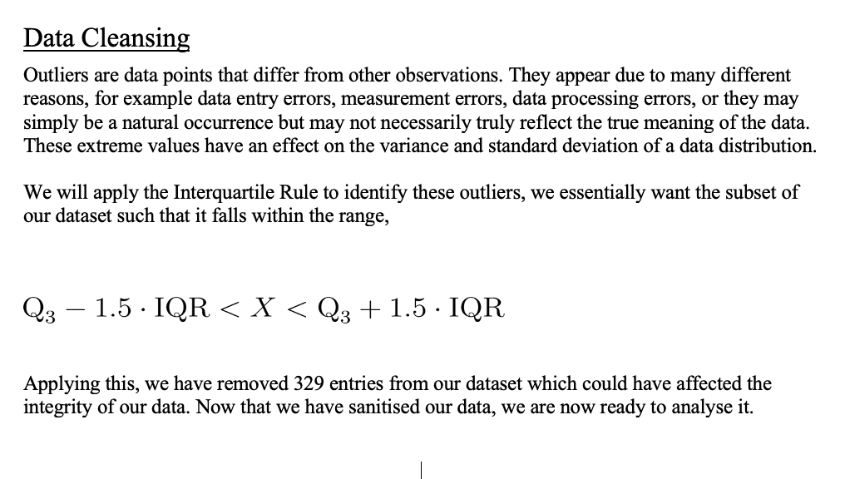
Data Cleansing Preface

Slide 4
Central Tendencies
Zone # | Mean
Zone 4 | 12.18455
Zone 1 | 10.78346
Zone 3 | 10.29804
Zone 2 | 9.832669
Zone 6 | 8.310714
Zone 5 | 5.619377
Zone 7 | 1.43299
Notes:
Assumptions
Zone 4 (Rural areas in southern Sweden) has the highest mean number of claims this could be because the infrastructure has not been as well maintained eg: lights, roading, stop signs and so on.
Zone 7 (Gotland) has the lowest number of claims as its population is far lower than that of southern Sweden, the population of Sweden is 10.23 million (2019) in contrast to the population of Gotland is only 58,464.

Slide 5
Central Tendencies
Make # | Mean
Make 9 | 16.45614
Make 1 | 15.47514
Make 6 | 11.00455
Make 5 | 8.869565
Make 2 | 7.709402
Make 7 | 5.931034
Make 3 | 5.757447
Make 4 | 5.724891
Make 8 | 4.238298
Notes:
Assumptions
The reason for Make 9 being the highest is perhaps that all other car models are included in this variable, there are roughly 60 different car manufactures and being that only 8 of them are put into other variables means that the rest (52) are put into the Make 9 variable therefore making it the highest as there is a lot more variability.
A possible reason for Make 8 being the lowest in terms of the mean number of claims is because these are cars that are owned by the average person who value reliability over anything else therefore resulting in the fewest number of claims.

Slide 6
Central Tendencies
Kilometers | Mean
1000-15000 | 11.57771
1000 | 9.793872
15000-20000 | 9.030055
20000-25000 | 5.858586
25000 | 4.98977
Notes:
Assumptions
We can assume that the reason for the highest number of claims for 1000-15000 variable is that drivers within this category are new drivers and have not yet obtained the level of driving skill required to have much fewer accidents while on the road
We can also assume that the reason for the variable 25000 having the fewest number of claims is that these drivers are the most experienced out of the bunch and therefore resulting in the fewest number of claims over a 12-month period

Slide 7
Dispersion Measures
 | Min | Q1 | Median | Mean | Q3 | Q3-Q1
Zone 4 | 0 | 3 | 7 | 12.18 | 17 | 14
Zone 2 | 0 | 2 | 6 | 9.8 | 14 | 12
Zone 3 | 0 | 2 | 6 | 10.3 | 14 | 12
Zone 1 | 0 | 3 | 7 | 10.78 | 14 | 11
Zone 6 | 0 | 1 | 3 | 8.3 | 11 | 10
Zone 5 | 0 | 0 | 2 | 5.6 | 7 | 7
Zone 7 | 0 | 0 | 0 | 1.4 | 1 | 1
Notes:
Talk about the Q3-Q1 how this shows the level of dispersion within the data

Slide 8
Dispersion Measures
 | Min | Q1 | Median | Mean | Q3 | Q3-Q1
Make 1 | 0 | 3 | 11 | 15.4 | 25 | 22
Make 9 | 0 | 5 | 13 | 16.4 | 24 | 19
Make 6 | 0 | 2 | 7 | 11 | 17 | 15
Make 5 | 0 | 1 | 5 | 8.8 | 13 | 12
Make 2 | 0 | 1 | 5 | 7.7 | 10 | 9
Make 4 | 0 | 0 | 1 | 5.7 | 7 | 7
Make 7 | 0 | 1 | 3.5 | 5.9 | 8 | 7
Make 3 | 0 | 0 | 2 | 5.7 | 6 | 6
Make 8 | 0 | 0 | 2 | 4.2 | 5 | 5
Notes:
Talk about the Q3-Q1 how this shows the level of dispersion within the data

Slide 9
Dispersion Measures
 | Min | Q1 | Median | Mean | Q3 | Q3-Q1
Kilometers 2 | 0 | 2 | 8 | 11.58 | 16 | 14
Kilometers 1 | 0 | 1 | 5 | 9.7 | 14.5 | 13.5
Kilometers 3 | 0 | 1 | 5 | 9.03 | 13 | 12
Kilometers 4 | 0 | 0 | 2 | 5.8 | 6 | 6
Kilometers 5 | 0 | 0 | 2 | 4.99 | 5 | 5
Notes:
Talk about the Q3-Q1 how this shows the level of dispersion within the data

Slide 10
Correlation Analysis
Our density plot is positively skewed for the distribution of Claims
p-value < 2.2e-16 as you can see our P value is smaller than 2.2e-16 meaning that is it basically negligible as the value is so small
But if the P value was more than 0.05 then it means the data is normally distributed
So as mentioned above this is the reason why I have gone with Spearman instead of Pearson’s for my correlation analysis

Slide 11
Correlation Analysis
Notes:
Gotland (Zone 7 CA = 0.9869706)
Assumptions
Gotland had the highest number of claims this in more than likely a direct correlation due to the number of people that live on the island of Gotland (58,464).
Due to the number of people and the claims it seems that although that their people living on gotland the claims there were made when we compare to the payment to the payment for this zone the correlation is very high.
This could be due to a number of things, infrastructure, location, laws, and many more things that we could make an assumption off

Slide 12
Correlation Analysis
Notes:
Small Cities (Zone 3 and Zone 5 CA = 0.92643)
Assumptions
Small Cities had the second number of claims, this could be because there are more people living in these areas but due to the size of the area this is heavily impacting the claims.
Another reason is that these areas have much many more cars.
Perhaps people living in these cities the vast majority drive but due to the size of where they live the likelihood of claims is much higher as we can see from the Correlation analysis

Slide 13
Correlation Analysis
Notes:
Rural Areas (Zone 4 and Zone 6 CA = 0.9225104)
Assumptions
We can assume that the reason for Rural areas having the third highest Correlation value is because of the not only the high number of claims made but the fact that the areas that are highly correlated are Zone 4 and Zone 6 which are the rural areas of Sweden
There could be a number of things that could happen in the rural areas of Sweden, a number of them could be due to the infrastructure, weather, perhaps free roaming animals in the roads, the rough terrain these a few things that could be heavily impacting the number of claims made from those areas hence our high correlation value

Slide 14
Academic Tutor
Notes:
Large Cites (Zone 1 and Zone 2 CA = 0.9014782)
Assumptions
Finally large cities had the lowest value in terms of the correlation analysis
This could be due to the fact that less people drive and take public transport
Being that the cities are so big they are therefore less congested resulting in less claims
Further adding to the above the infrastructure in terms of the road worthy ness of the roads and the stop lights are very heavily maintained resulting in less claims for people living in these areas

Slide 15
Correlation Analysis
Make # | Correlation Value
Make 4 | 0.9654472
Make 1 | 0.9374646
Make 2 | 0.9333129
Make 3 | 0.9332873
Make 9 | 0.9283497
Make 6 | 0.9254517
Make 5 | 0.9174462
Make 8 | 0.9075048
Make 7 | 0.9056136
Notes:
Assumptions
Make 4 had the highest value of CA = 0.9654472 which was the highest number of claims for the Make 4 variable
We can see from the line of best fit that the values are have a lot of variance but due to the CA value of 0.9654472 we know that the variables claims and payment within Make 4 are highly correlated and this make in particular has the highest correlation value.

Slide 16
Correlation Analysis
Make # | Correlation Value
Make 4 | 0.9654472
Make 1 | 0.9374646
Make 2 | 0.9333129
Make 3 | 0.9332873
Make 9 | 0.9283497
Make 6 | 0.9254517
Make 5 | 0.9174462
Make 8 | 0.9075048
Make 7 | 0.9056136
Notes:
Assumptions
Make 7 had the lowest value of CA with = 0.9056136
While the correlation between the Make 7 claims and the payment the variables are very spread out and varied showing that while when the claims increase so does the payment, but the claims are not going to be consistent
To further add to the above the claims themselves within the Make 7 have a lot of variance within them but are still highly correlated once put against the payment variable but within our dataset this is the lowest.

Slide 17
Correlation Analysis
Notes:
We can see from our correlation analysis value of 0.9388519 that the claims variable and the payment variable are highly correlated resulting in a strong positive relationship, as the claims increase so does the payment made by the Swedish insurance company.

Slide 18
Correlation Analysis
Notes:
We can see from our correlation analysis value of 0.8458319 that the insured variable and the payment variable are highly correlated resulting in a strong positive relationship, as the number of insured increase so does the payment made by the Swedish insurance company.

Slide 19
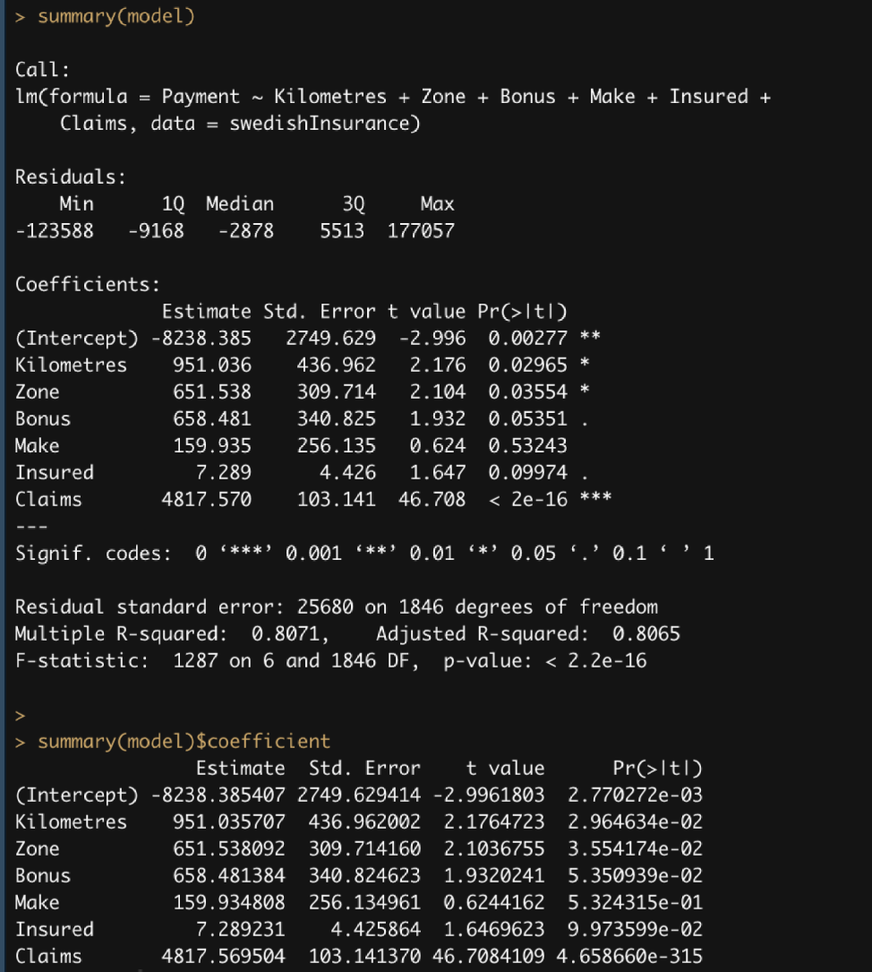
Payment Regression Model
Variable | Std. Error
Insured | 4.425864
Claims | 103.141370
Make | 256.134961
Zone | 309.714160
Bonus | 340.824623
Kilometers | 436.962002
Variable | P-Value
Kilometers | 2.770272e-03
Zone | 2.964634e-02
Bonus | 3.554174e-02
Insured | 5.324315e-01
Make | 5.350939e-02
Claims | 9.973599e-02
Model Equation
Payment = -8238.38 + 951.03 Kilometers + 651.53 Zone +
658.48 Bonus + 159.93 Make + 7.28 Insured + 4817.56 Claims
Notes:
• Std.Error: the standard error of the coefficient estimates. As we can see the Insured variable is the smallest as this represents the accuracy of the coefficient. Because Insured has the smallest Std.Error this shows that it has the highest level of confidence regarding the estimate. Furthermore, Kilometres in regard to the Std.Error this shows that it has the lowest level of confidence.
• Pr(>|t|): The p-value corresponding to the t-statistic. Because Kilometres has the smallest p-value, it shows it is the most significant estimate, additionally Claims has the highest p-value this shows that this has the least significant estimate for our model.
Model Equation
Payment = -8238.38 + 951.03 Kilometers + 651.53 Zone +
658.48 Bonus + 159.93 Make + 7.28 Insured + 4817.56 Claims

Slide 20
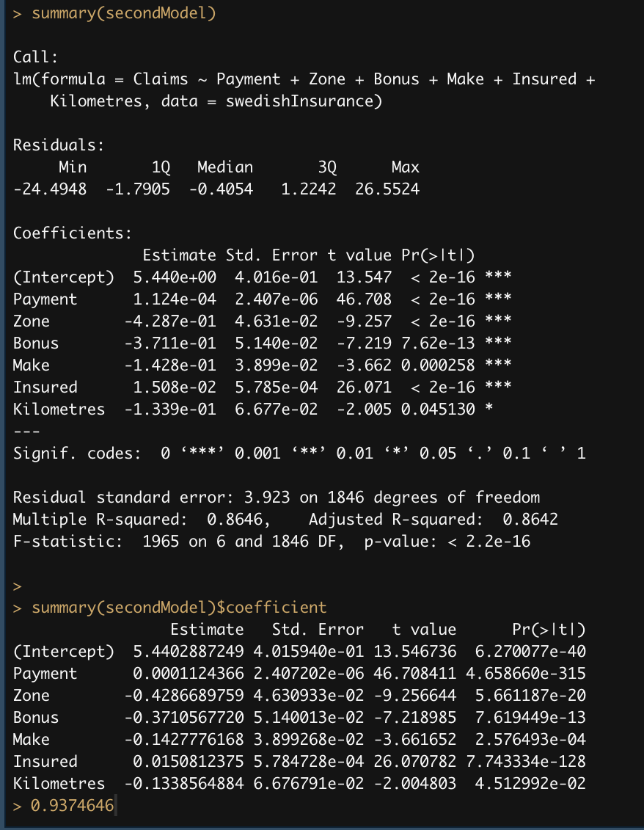
Claims Regression Model
Variable | Std. Error
Payment | 2.407202e-06
Make | 3.899268e-02
Zone | 4.630933e-02
Bonus | 5.140013e-02
Insured | 5.784728e-04
Kilometers | 6.676791e-02
Variable | P-Value
Make | 2.576493e-04
Kilometers | 4.512992e-02
Payment | 4.658660e-315
Zone | 5.661187e-20
Bonus | 7.619449e-13
Insured | 7.743334e-128
Model Equation
Claims = 5.44 + 0.0011 Payment + - 0.42 Zone + - 0.37 Bonus
+ - 0.14 Make + 0.01 Insured + - 0.13 Kilometers
Notes:
Std.Error: the standard error of the coefficient estimates. As we can see the Payment variable is the smallest as this represents the accuracy of the coefficient. Because Payment has the smallest Std.Error this shows that it has the highest level of confidence regarding the estimate. Furthermore, Kilometres in regard to the Std.Error this shows that it has the lowest level of confidence.
• Pr(>|t|): The p-value corresponding to the t-statistic. Because Make has the smallest p-value, it shows it is the most significant estimate, additionally Insured has the highest p-value this shows that this has the least significant estimate for our model.
Model Equation
Claims = 5.44 + 0.0011 Payment + - 0.42 Zone + - 0.37 Bonus
+ - 0.14 Make + 0.01 Insured + - 0.13 Kilometers

Slide 21
Conclusion
From my exploratory data analysis, I have been able to show which variables have the highest or the lowest impact on the claims & Payment variable and further have been able to show which risk categories have the highest and lowest level of impact on the claims. Going forward with this piece of presented information the Swedish Committee is now able to make the necessary adjustments to how they protect their customers depending on the risk categories that have been supplied by the committee.

